Slide 1
Web-editor for reproducible pipelines
Resources and microservices

Slide 2
Product description
A web application and a visual studio code extension for editing pipelines with auto-saving and automatic syntax and cohesion checking, embedded into the “MLOps Platform”.
MLDev experiments configurations CRUD.
Online editor with syntax highlighting, formatting.
Real Time collaboration with built-in git support system.
Experiments visualizer.
Team: Daniil Fedorov (Architect, system analyst), Sergeev Ilya (Architect, full-stack developer), Shtanov Andrey (Architect, UI-developer)
Repo: https://github.com/dr0p-table-users/asd
Report: https://docs.google.com/presentation/d/1pje2W9pGmORkrRjzaBEfAczLazg_F9HpnyR5zC0pUDA/edit?usp=sharing

Slide 3
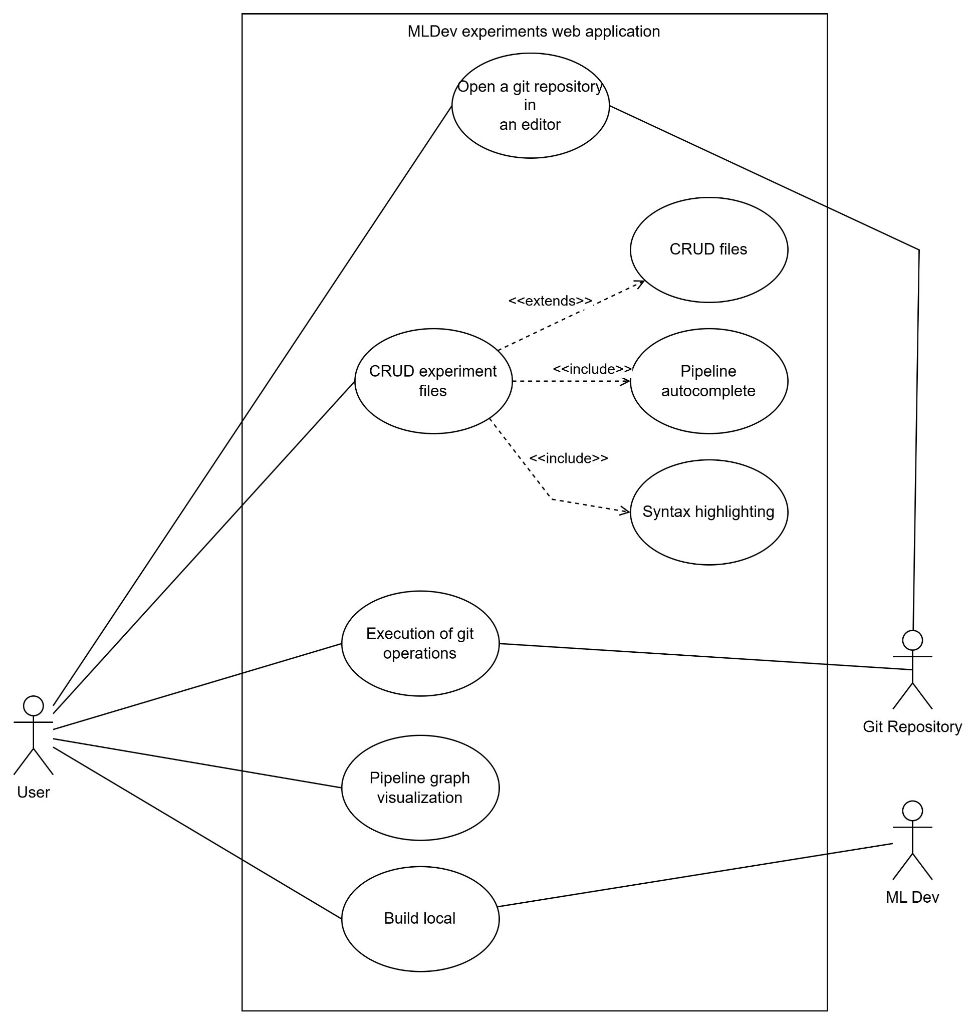
Use case diagram

Slide 4
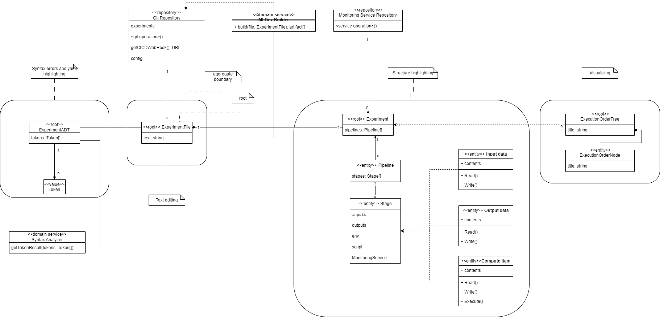
Detailed class diagram - All Aggregates

Slide 5
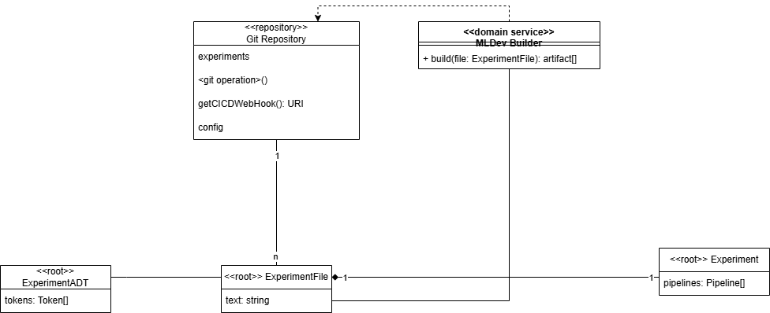
Detailed class diagram - Aggregate ExperimentFile

Slide 6
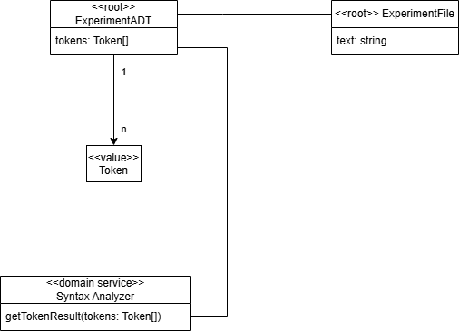
Detailed class diagram - Aggregate ExperimentADT

Slide 7
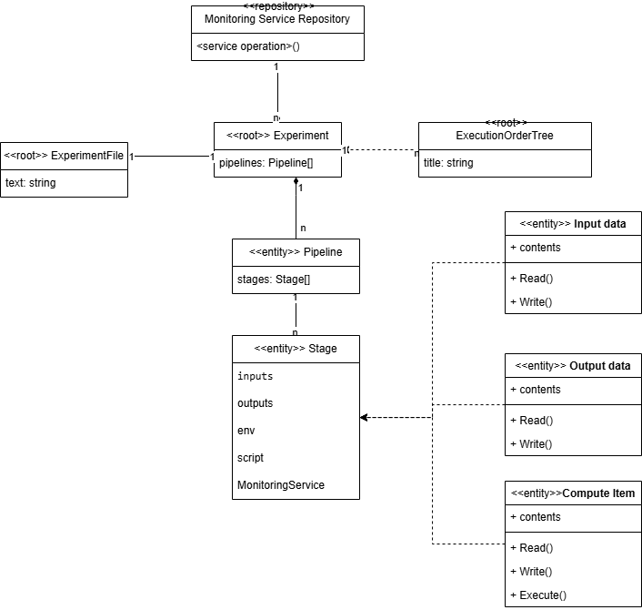
Detailed class diagram - Aggregate Experiment

Slide 8
Detailed class diagram - Aggregate ExecutionOrderTree

Slide 9
Service diagram
Draw a UML2 component diagram or physical DFD with microservices and their interfaces/data exchanges
Also include dependencies on external services
<At least one service/component per team member>

Slide 10
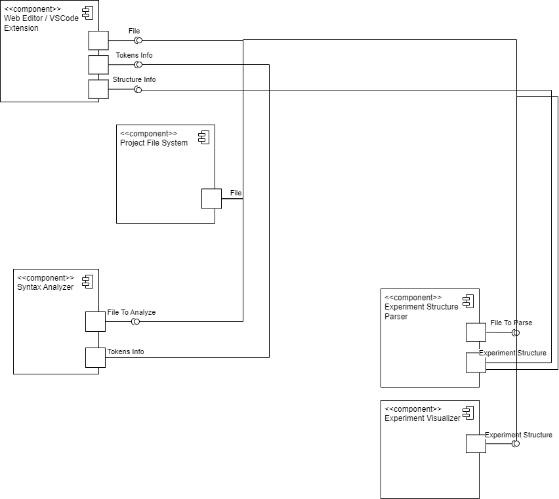
Service diagram

Slide 11
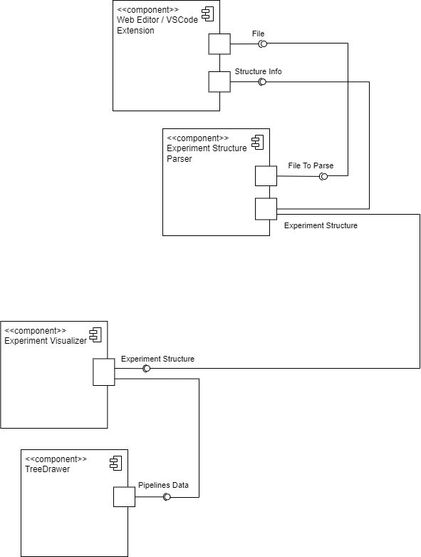
Service diagram
Андрей

Slide 12
Traceability
Microservice (component) | Resource (interface) | Domain classes in the microservice | Use case that use the microservice
Syntax Analyzer | File to analyze | Experiment ADT | Analyzing the language syntax
Visualizer | Experiment Structure | Tree Drawer | Pipeline graph visualization
Structure Parser | File to parse | Experiment | Create a structured representation and highlight syntax
Web Editor | File | Experiment File | Edit the experiments contents

